Slide 1


MP-A-12
BHOJ REDDY ENGINEERING COLLEGE FOR WOMEN DEPARTMENT OF INFORMATION TECHNOLOGY III B Tech. II Sem. A Section Mini Project Final Seminar Academic Year 2025-26 Date: 05-06-2025 Liver Disease Prediction using Supervised Learning
PRESENTED
BY
Thota Pragna Bharathi 22321A1263
A.Akshaya 23325A1201
V.Navya sree 23325A1207
Ishrath nousheem Tasneem Rahath Dr C Murugamani
Project Guide Co Ordinator HOD-IT

Slide 2
CONTENTS
Introduction
Existing System
Proposed System
Functional Requirements
Non functional Requirements
Modules
Technical Architecture
System Architecture
Computational Resources
UML diagrams
Implementation
Screenshots
Test Cases
Conclusion
Future Scope
References

Slide 3
INTRODUCTION
Liver diseases such as cirrhosis, hepatitis, and fatty liver disease are major global health concerns, causing significant mortality.
Early detection is crucial for improving treatment outcomes and reducing healthcare costs.
Traditional diagnostic methods rely on complex medical tests, which are time-consuming and expensive.
The model will be integrated into a user-friendly web application for real-time risk assessment.
Machine learning provides a powerful approach for predicting liver disease based on patient data.

Slide 4
EXISTING SYSTEM
Diagnosing liver disease traditionally requires expensive and time-consuming medical tests, such as blood tests, imaging, and biopsies.
Current systems often rely on rule-based or statistical models, which may lack adaptability to complex patterns in patient data.
Many existing machine learning models for liver disease prediction face challenges in selecting the right algorithm, leading to poor accuracy and unreliable predictions.
Some models suffer from high computational costs, making real-time diagnosis difficult.
Most systems lack a user-friendly interface, making it hard for healthcare professionals and patients to access and interpret results easily.

Slide 5
DISADVANTAGES:
Limited Accuracy
Lack of User-Friendly Interface
High Computational Cost
Limited Generalization

Slide 6
PROPOSED SYSTEM
The proposed system utilizes machine learning techniques to predict liver diseases efficiently.
The datasets undergo preprocessing to remove inconsistencies, outliers, and irrelevant data, ensuring high-quality input for the model.
Machine learning algorithms such as Logistic Regression, KNN, SVM, and ANN are implemented to detect patterns and make accurate predictions.
The trained model is deployed in a user-friendly web application, allowing healthcare professionals and individuals to input medical data and receive real-time predictions.
This system offers a scalable, accessible, and efficient solution for early liver disease detection, supporting timely medical interventions and improved healthcare decision-making.

Slide 7
ADVANTAGES
Cost Efficiency
Efficient Trend Identification
Time-Efficient Diagnosis
Enhanced Simulation Capabilities
Handling Multi-Dimensional Data
Enhanced Prediction Accuracy

Slide 8
FUNCTIONAL REQUIREMENTS
The system must efficiently process patient medical data, ensure accurate disease prediction, and provide insightful visualizations. It should support data input, preprocessing, model training, performance evaluation, and interactive result display.
• User Authentication & Access Control
• Data Input & Preprocessing
• Disease Prediction Using Machine Learning
• Model Performance Evaluation & Comparison
• User-Friendly Web Interface
Report Generation & Visualization

Slide 9
NON-FUNCTIONAL REQUIREMENTS
The system must ensure high performance, security, scalability, and usability to provide an efficient and reliable liver disease prediction platform. It should support fast processing, seamless user experience, and secure data handling..
Performance Efficiency
Security
Scalability
Usability
Reliability
Compatibility
Maintainability

Slide 10
MODULES
1. User Authentication & Access Control Module
Using this module user will get register by giving required data to register.
After successful register user will login to the application.
2. User Input Module
Using this module user will give input for prediction.
Input contains 10 attributes which are taking from patient’s blood report.
3. Disease Prediction Module
Using this module final predicted result displayed.
By clicking submit button after giving the input will displays the predicted result.

Slide 11
4. Model Evaluation Module
Assesses model performance using metrics like RMSE and R²
Compares different models to select the best-performing one.
5. User Logout Module
Using this module user will get logout from the application.

Slide 12
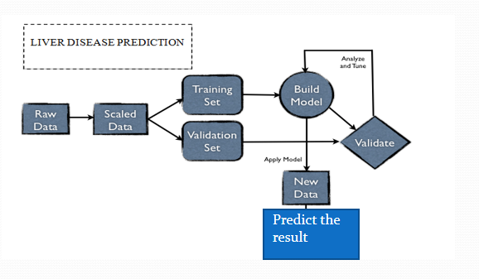
SYSTEM ARCHITECTURE

Slide 13
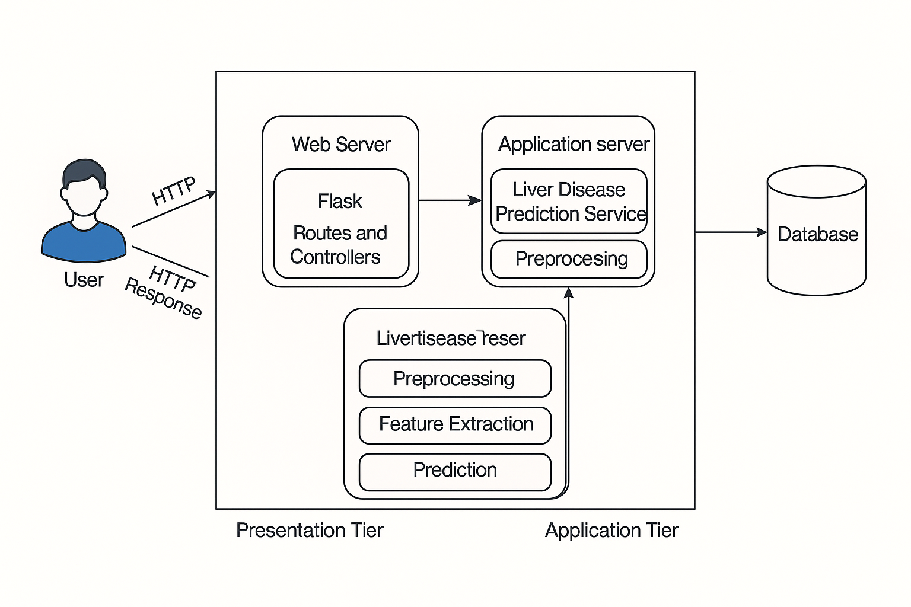
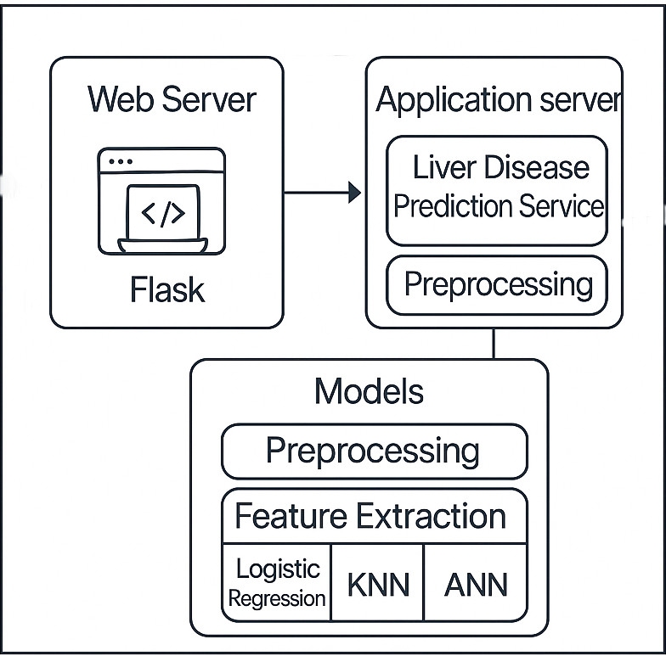
TECHNICAL ARCHITECTURE

Slide 14
COMPUTATIONAL RESOURCES
Hardware Requirements:
Processor : Intel COREi51.80 GHz
RAM : 8GB
ROM : 1TB
Software Requirements:
Operating System : Windows 10
IDE : Anaconda 3.7,Google colab
Language Used : Python 3.7
Front End : Html,css,Bootstrap
Data Processing : Pandas, NumPy
Machine Learning : Logistic Regression,KNN,ANN,SVM
Visualization : Matplotlib, Seaborn
Web Framework : Flask

Slide 15
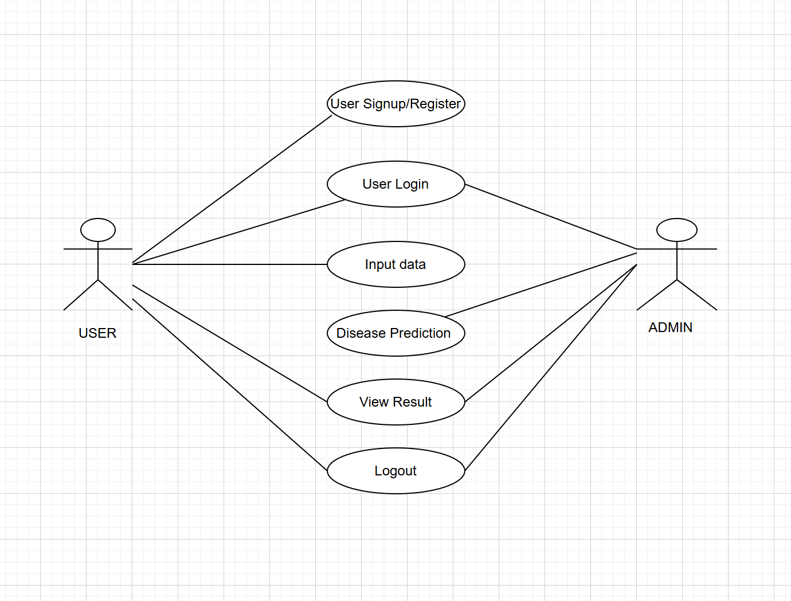
Use case diagram:
UML DIAGRAMS

Slide 16
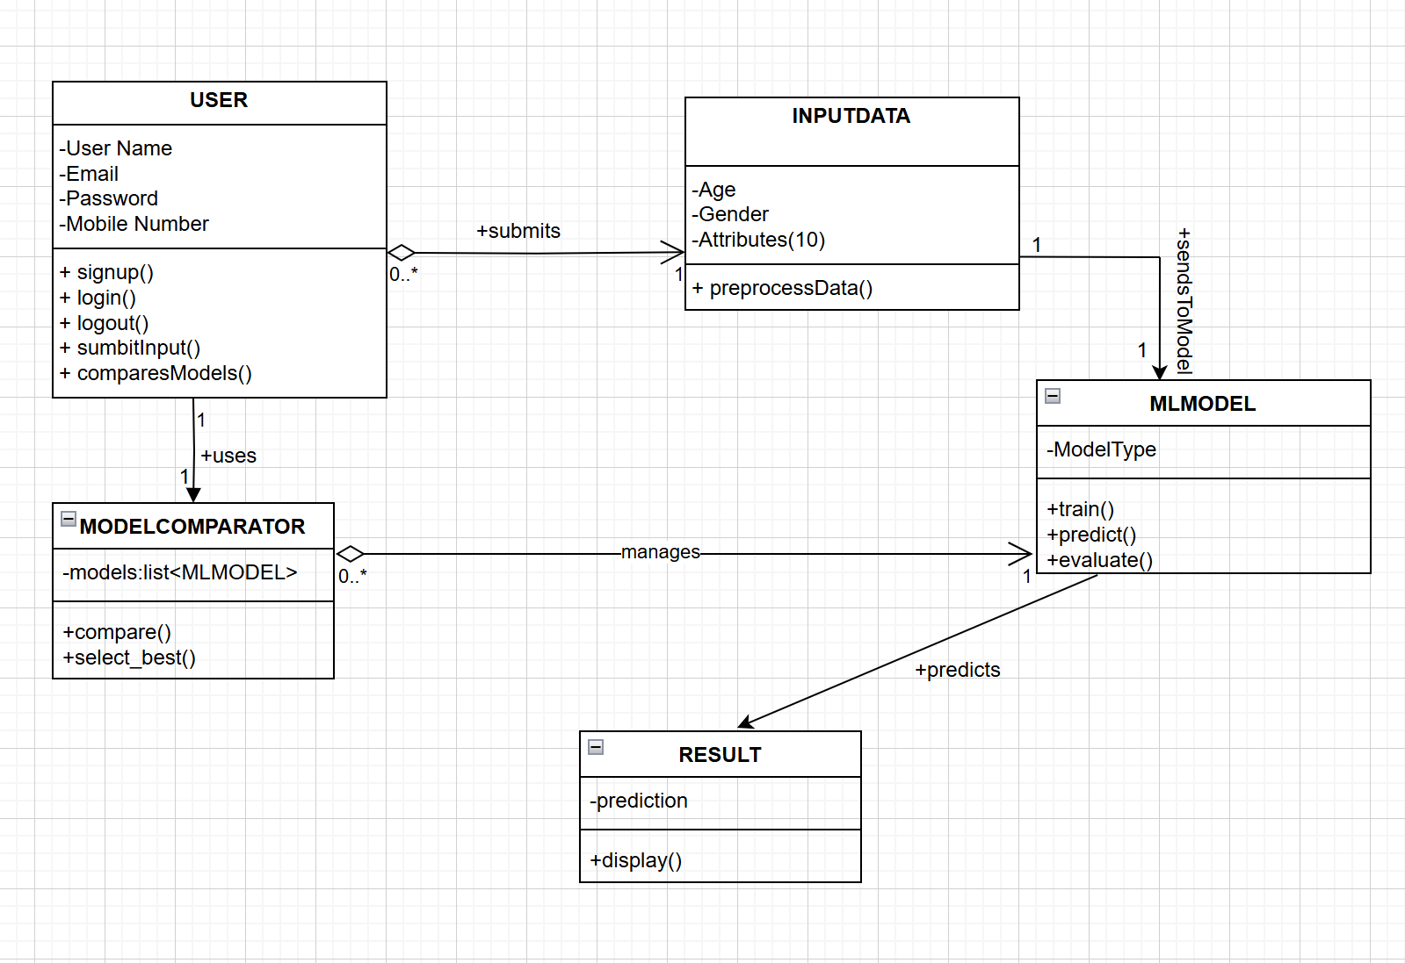
Class diagram:

Slide 17
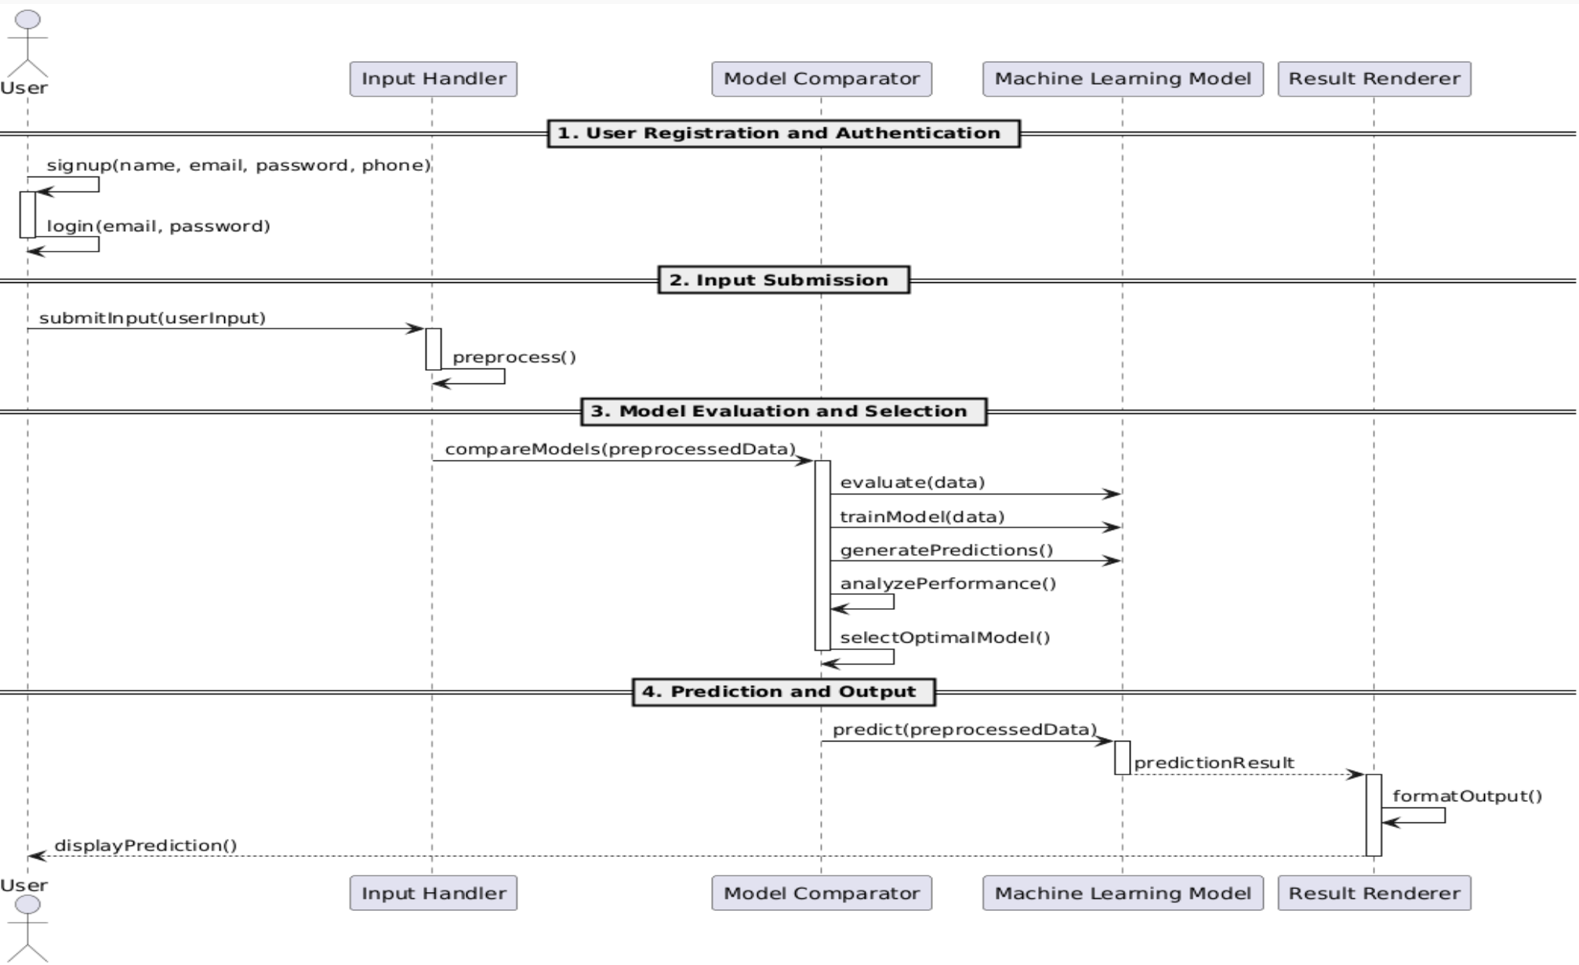
Sequence diagram

Slide 18
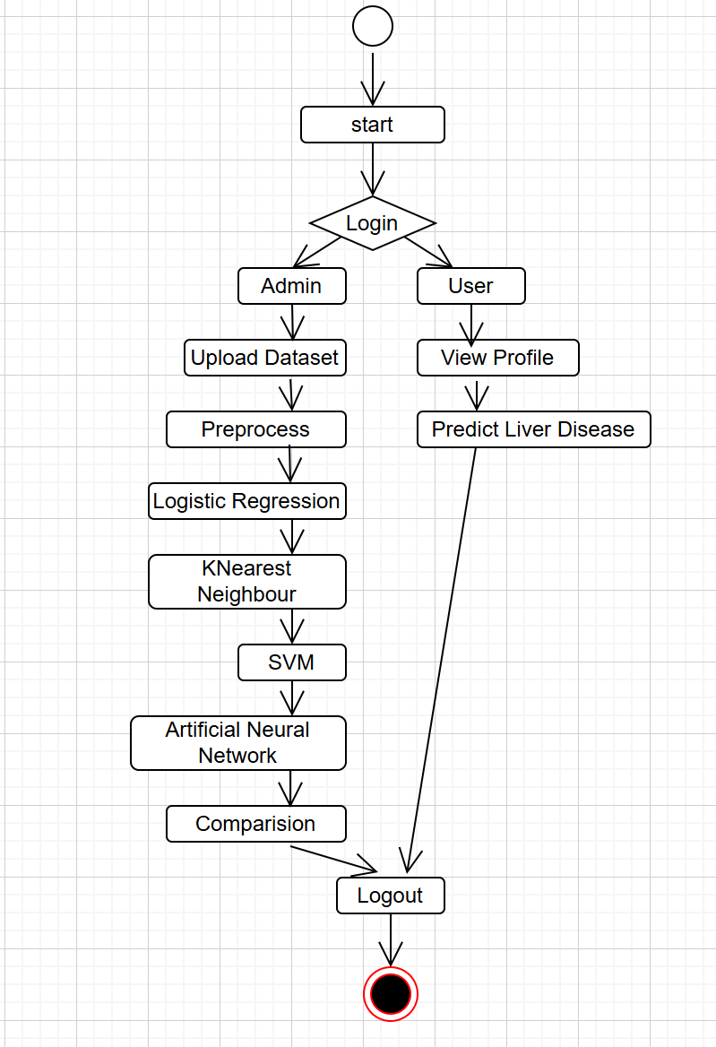
Activity diagram:

Slide 19
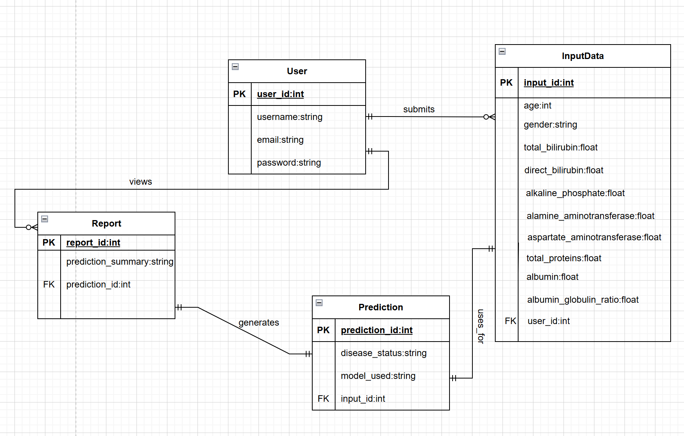
ER diagram:

Slide 20
Implementation
from flask import Flask, request, render_template
import pickle
import pandas as pd
import sqlite3
app = Flask(_name_)
model = pickle.load(open("model.pkl", "rb"))
# Database connection function
def db_connection():
conn = sqlite3.connect('signup.db')
return conn

Slide 21
# User sign-up
@app.route("/signup", methods=["GET"])
def signup():
username = request.args.get('user')
name = request.args.get('name')
email = request.args.get('email')
number = request.args.get('mobile')
password = request.args.get('password')
conn = db_connection()
cur = conn.cursor()
cur.execute("INSERT INTO info (user, email, password, mobile, name) VALUES (?, ?, ?, ?, ?)",
(username, email, password, number, name))
conn.commit()
conn.close()
return render_template("signin.html")

Slide 22
# User sign-in
@app.route("/signin", methods=["GET"])
def signin():
username = request.args.get('user')
password = request.args.get('password')
conn = db_connection()
cur = conn.cursor()
cur.execute("SELECT user, password FROM info WHERE user = ? AND password = ?", (username, password))
data = cur.fetchone()
conn.close()
if data:
return render_template("index.html")
else:
return render_template("signin.html")

Slide 23
# Prediction
@app.route('/predict', methods=['POST'])
def predict():
input_features = [request.form[str(i)] for i in range(1, 11)]
row_df = pd.DataFrame([input_features])
prediction = model.predict_proba(row_df)
output = '{0:.{1}f}'.format(prediction[0][1], 2)
output = str(float(output) * 100) + '%'
if float(output[:-1]) > 50:
return render_template('result.html', pred=f'You have a chance of having Liver Disease. Probability of Liver Disease is {output}')
else:
return render_template('result.html', pred=f'You are safe')

Slide 24
# Home, login, logon, note, index routes
@app.route('/')
def home():
return render_template("home.html")
@app.route('/logon')
def logon():
return render_template('signup.html')
@app.route('/login')
def login():
return render_template('signin.html')
@app.route('/note')
def note():
return render_template('notebook.html')
@app.route('/index')
def index():
return render_template('index.html')
if _name_ == '_main_':
app.run(debug=True)

Slide 25
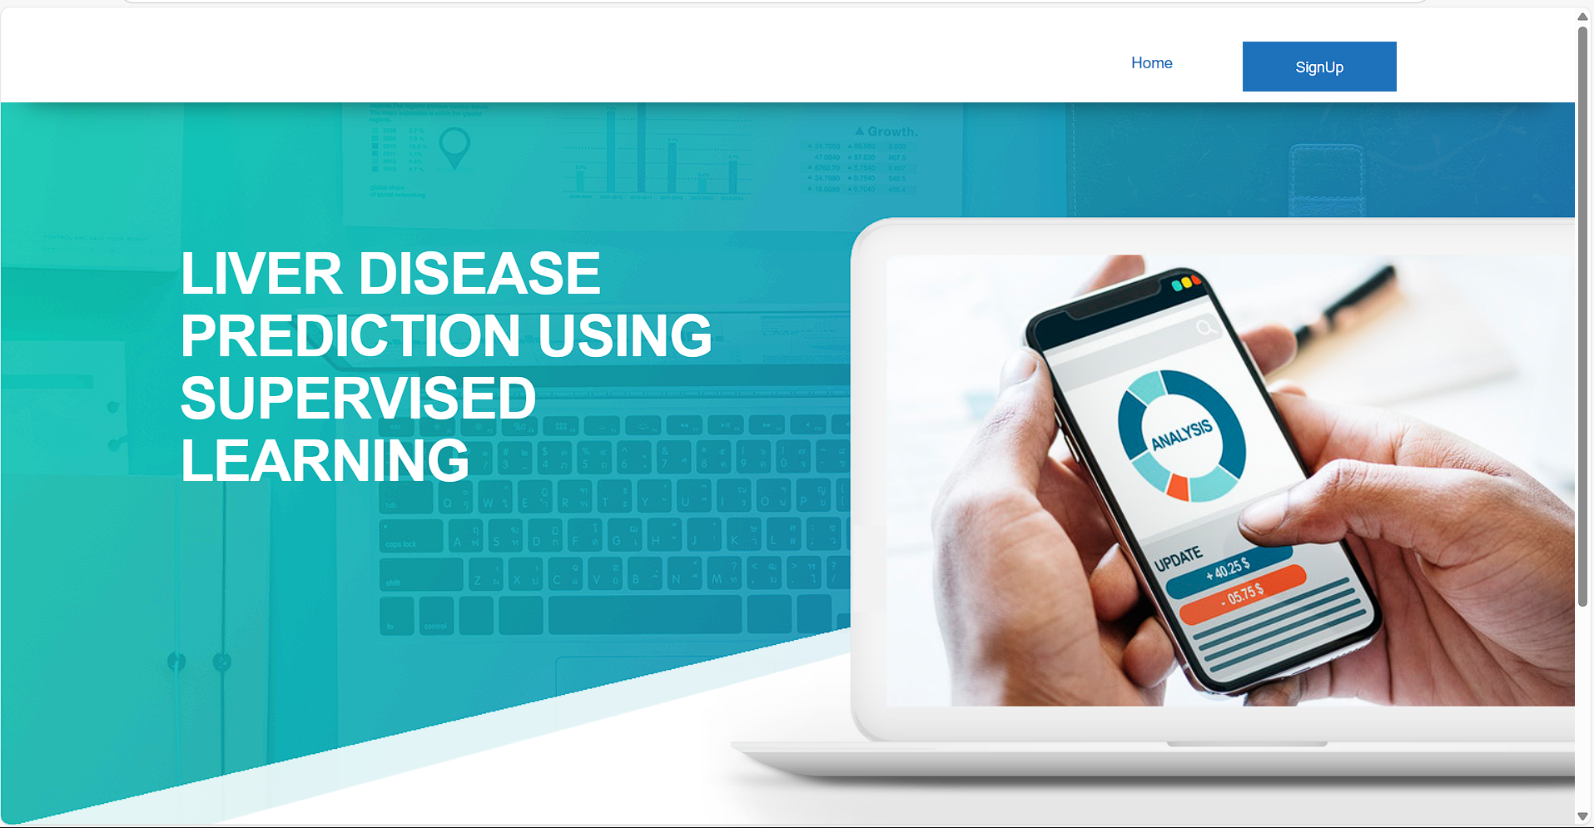
Screenshots

Slide 26
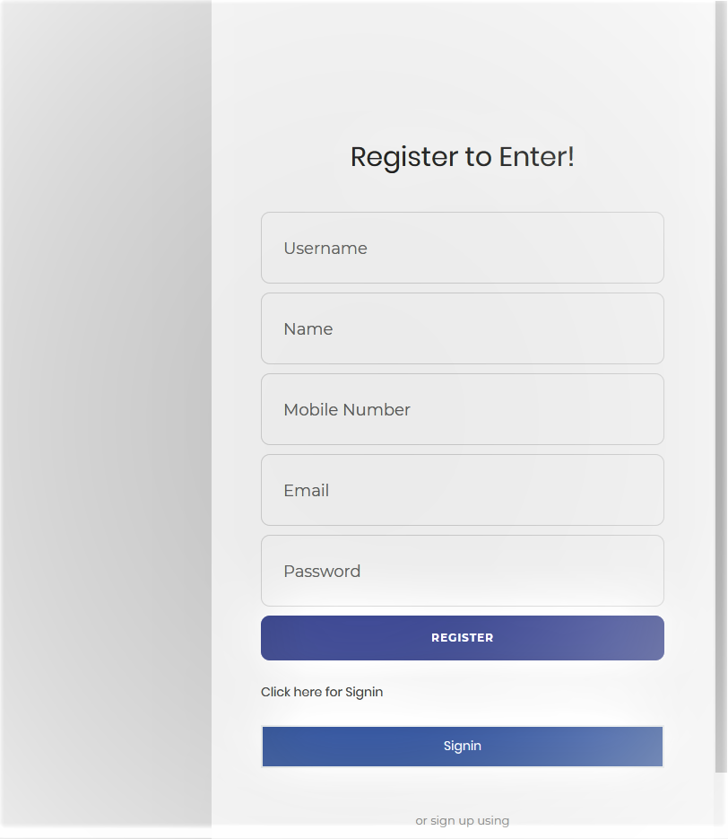
Register:

Slide 27
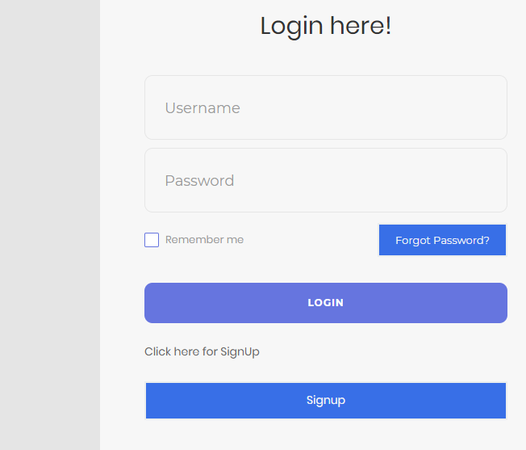
Login:

Slide 28
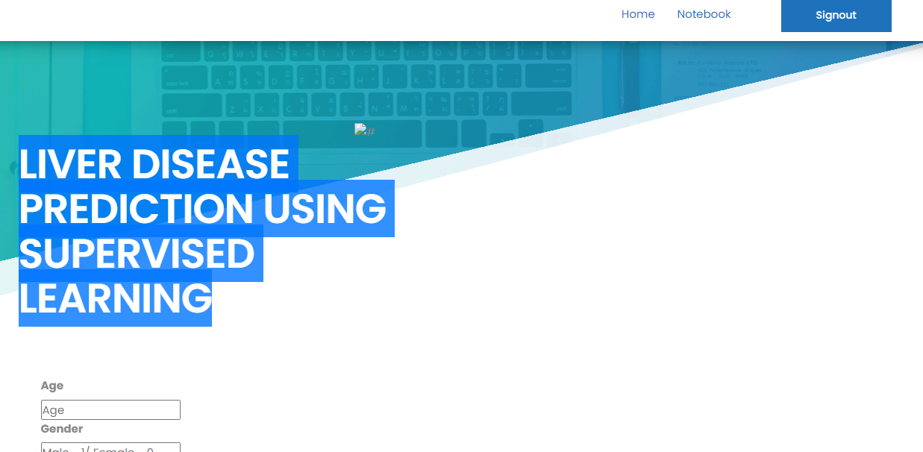

Slide 29
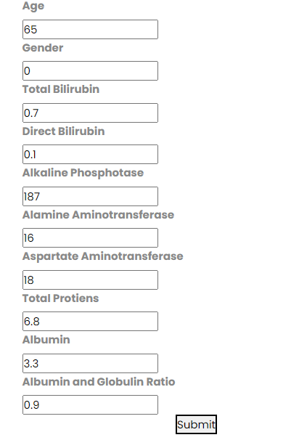

Slide 30
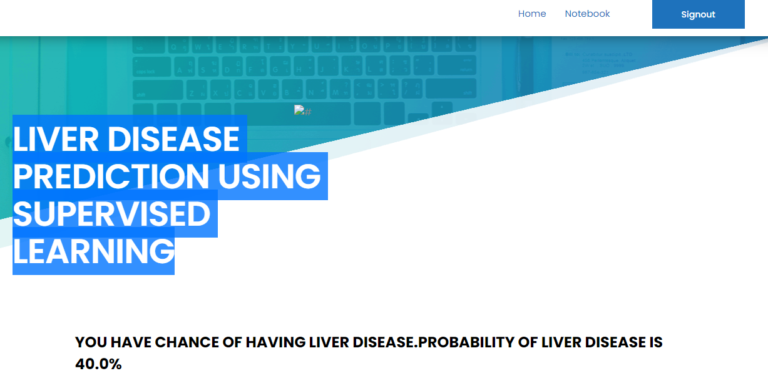

Slide 31
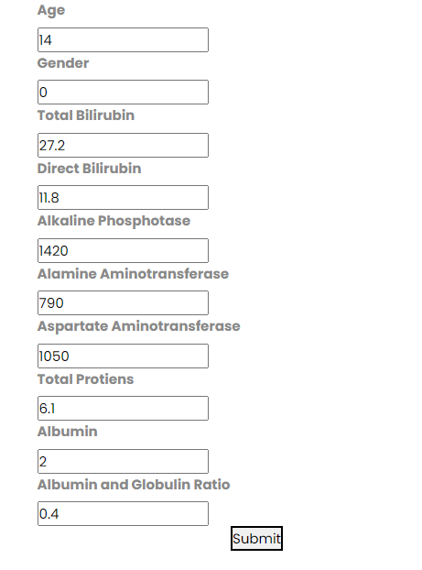

Slide 32
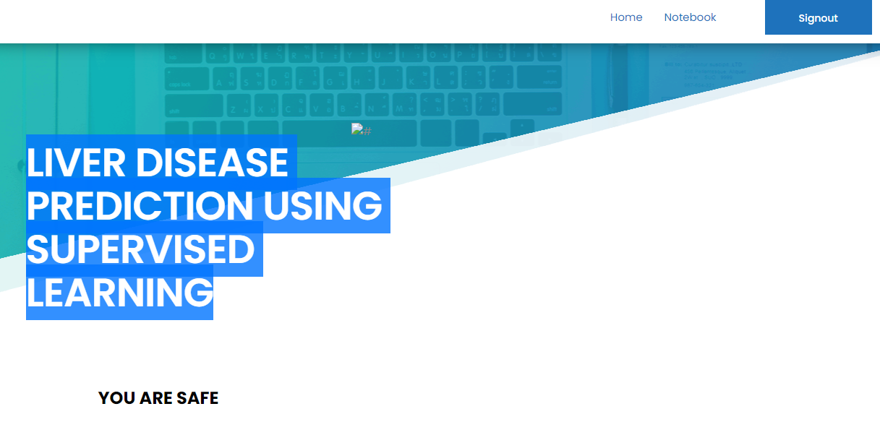

Slide 33
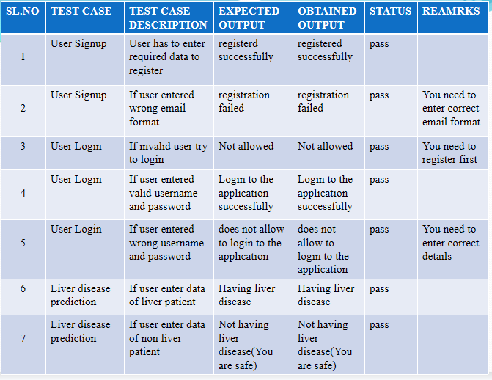
Test cases:

Slide 34
Conclusion
In this project, we have proposed methods for diagnosing liver disease in patients using machine learning techniques. The four machine learning techniques that were used include SVM, logistic regression, KNN and Artificial Neural Network. This study demonstrates that there is a significant difference between the proposed rules based classification model and the model without rules for the liver diseases prediction and the rule based classification model with decision tree (DT) technique provides most accurate result. This model can be used as a valuable tool for medical decision making.
The system was implemented using all the models and their performance was evaluated. Performance evaluation was based on certain performance metrics. ANN was the model that resulted in the highest accuracy with an accuracy of 98%. Comparing this work with the previous research works, it was discovered that ANN proved highly efficient. A GUI, which can be used as a medical tool by hospitals and medical staff was implemented using ANN.

Slide 35
Future Scope
This project lays a strong foundation for liver disease prediction using supervised learning, but there is ample scope for further development. Future enhancements may include integrating the system with hospital databases or electronic health records to enable real-time data input and continuous model updates.Advanced deep learning algorithms like Convolutional Neural Networks (CNNs) and Recurrent Neural Networks (RNNs) can be explored to improve prediction accuracy, especially when combined with medical imaging data. A mobile or cloud-based version of the system could be developed to increase accessibility for patients and doctors in remote areas.

Slide 36
References
[1]Michael J Sorich. An intelligent model for liver disease diagnosis. Artificial Intelligence in Medicine 2009;47:53—62.
[2]Paul R. Harper, A review and comparison of classification algorithms for medical decision making.
[3] BUPA Liver Disorder Dataset. UCI repository machine learning databases.
[4]Prof Christopher N. New Automatic Diagnosis of Liver Status Using Bayesian Classification
[5] Schiff's Diseases of the Liver, 10th Edition Copyright ©2007 Ramana, Eugene R.; Sorrell, Michael Maddrey, Willis C.
[6] P. Sug, On the optimality of the simple Bayesian classifier under zero-one loss, Machine Learning 29 (2–3) (1997) 103–130.
[7] 16th Edition HARRISON’S PRINCIPLES of Internal Medicine

Slide 37
[8] aparna behara and m.v. raghunadh, “real time faces recognition system for time and attendance applications”, International Journal of Electrical, Electronics and Data Communication, Volume- 1, Issue- 4, ISSN: 2320-2084.2009
[9] National Plan for Liver Services UK (2009) A Timeto Act: Improving Liver Health and Outcomes in Liver disease www.bsg.org.uk/sections/liverarticles/thenational-planfor-liver-services-uk-2009.html
[10] S. Ansari I. Shafi J. Ahmad S. Ismail Shah, Neural network-based approach for the noninvasive diagnosis and classification of hepatotropic viral disease, Communications, IET, Vol. 6, 2012, 3265 – 3273.
[11] L. Fausett, Fundamentals of neural networks architectures, algorithms, and applications, Pearson Education, Inc., 2008.
[12] https://www.medicinenet.com/liver_disease/article.htm

Slide 38


